Slide 1



Robust background modelling of copy number alterations data
Aditya Deshpande
Karolina Sienkiewicz
Christoph Kreitzer

Slide 2
Outline
Biases influencing estimation of CNAs
Dryclean
Implementation of DryClean for IMPACT data
Results

Slide 3
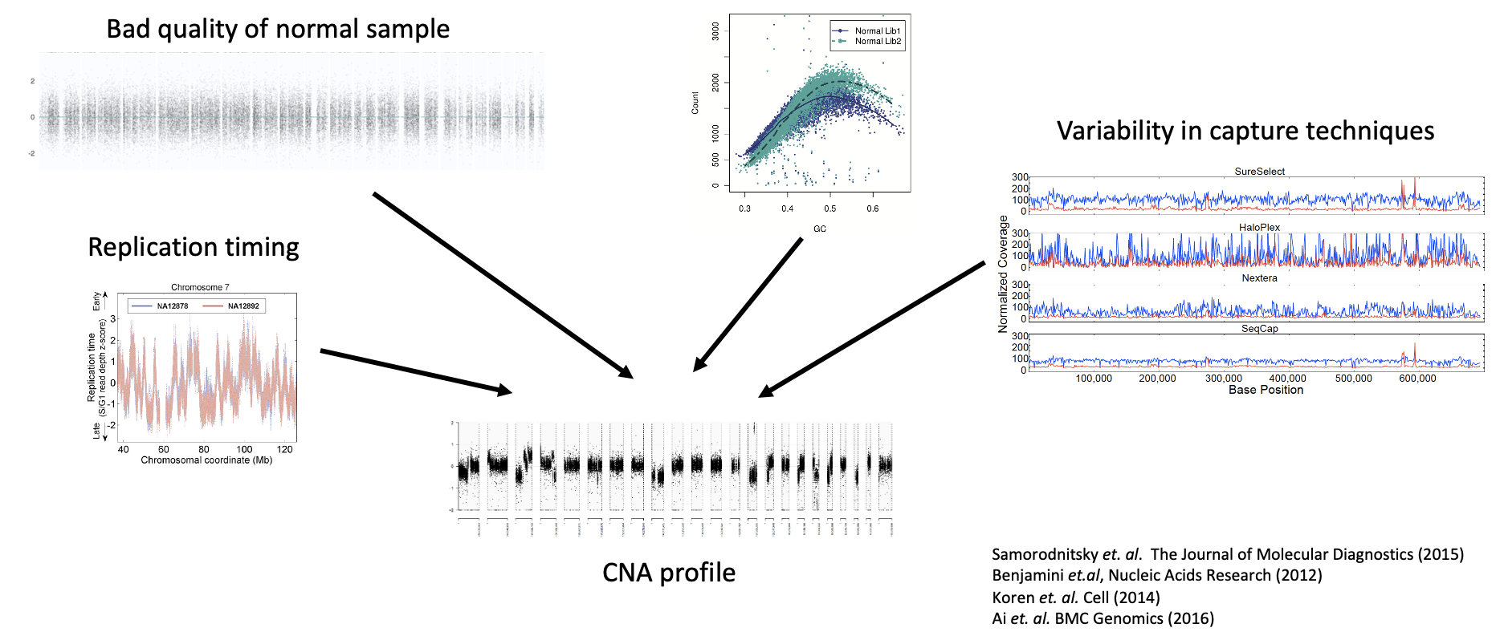
CNA inference: Multiple factors affect CNA calling

Slide 4
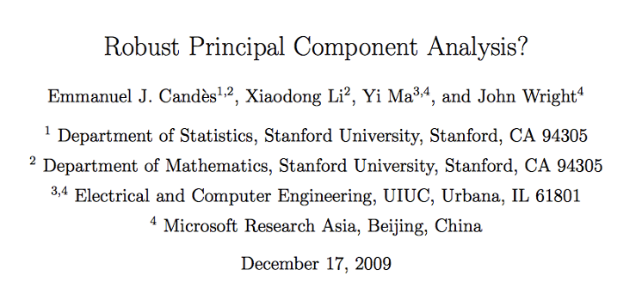
Robust Principal Component Analysis (rPCA)
• rPCA is one of the approaches to find low rank approximation of a matrix that is contaminated by gross anomalies
• It has been used in separating foreground from background in video surveillance, face recognition, etc.

Slide 5
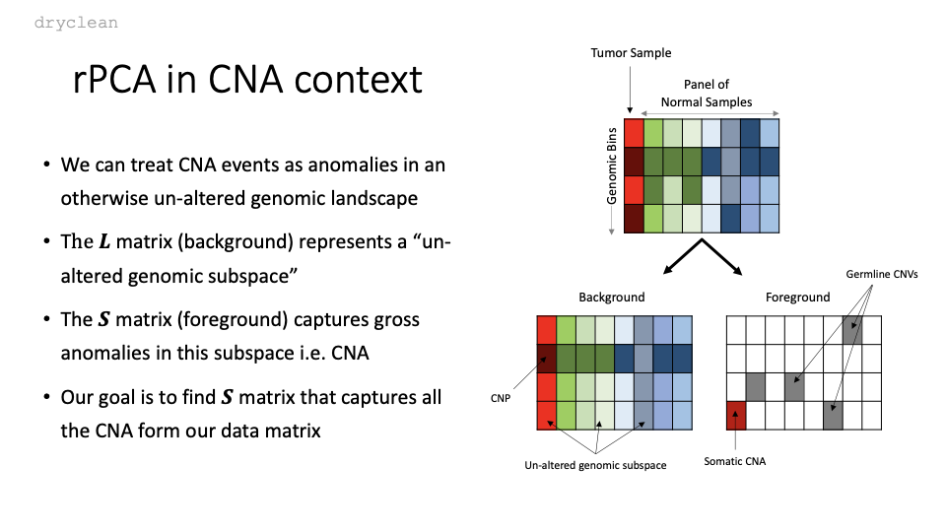

Slide 6
Implementation of dryclean for IMPACT

Slide 7
Background and Data
Breast Invasive Ductal Carcinomas
IMPACT targeted panel sequencing (gene panel 468)
uneven ‘probe-distribution’ throughout the genome (Addy updated the script)
PON: 147,182 x 992
Following results: n = 65 BRCA cases (low and high purity group; WES available)

Slide 8
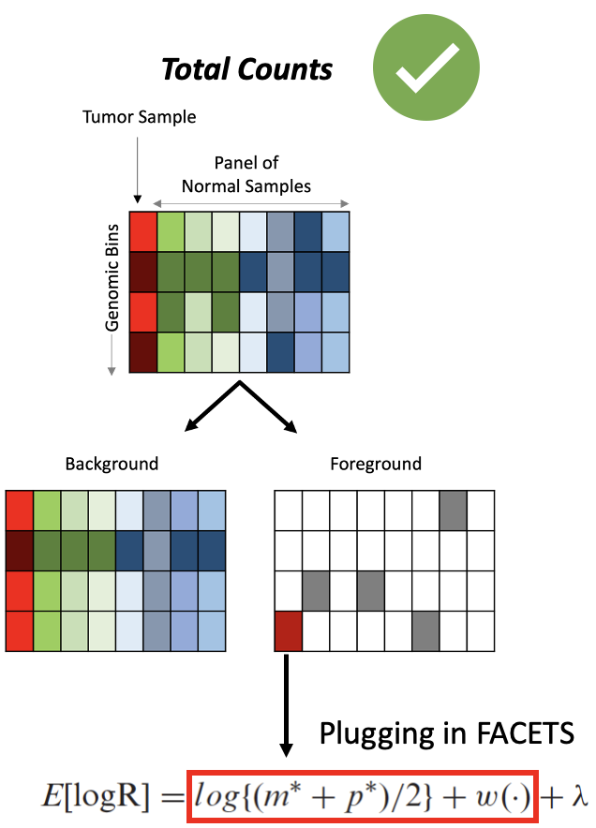
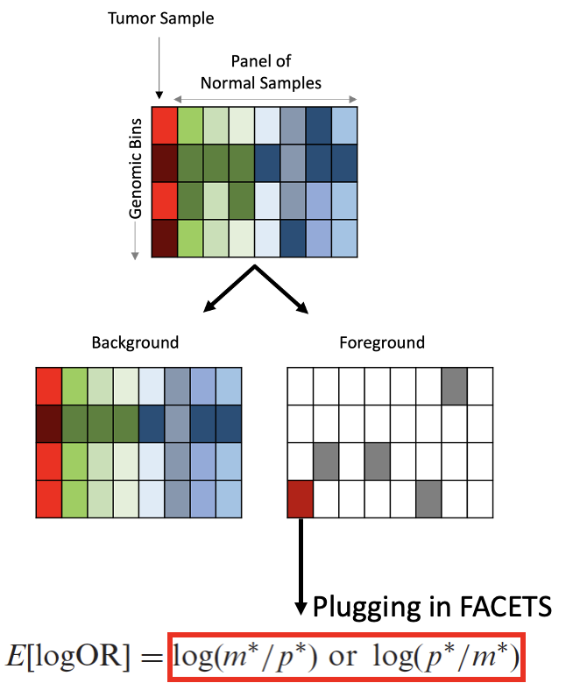
CnLR across the genome will systematically be replaced
Alt Counts
allele-specific estimate [logOR];
stay with original point estimate
[...there is no indication of systematic bias, hence an allele-specific PON can be neglected]

Slide 9
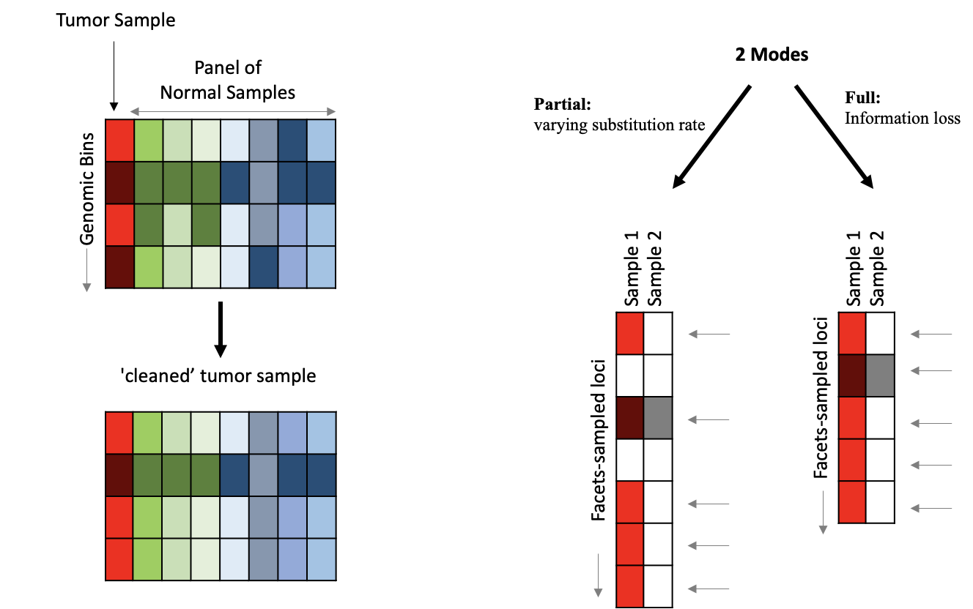
The implementation of DryClean with two modes

Slide 10
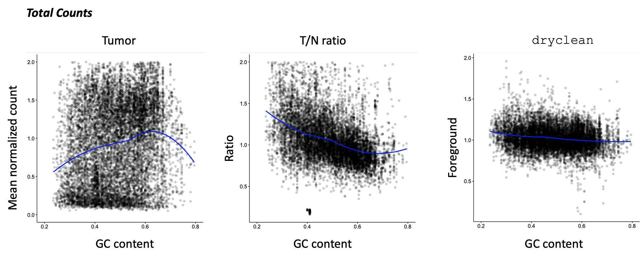
DryClean removes GC bias in IMPACT data
Result 1

Slide 11
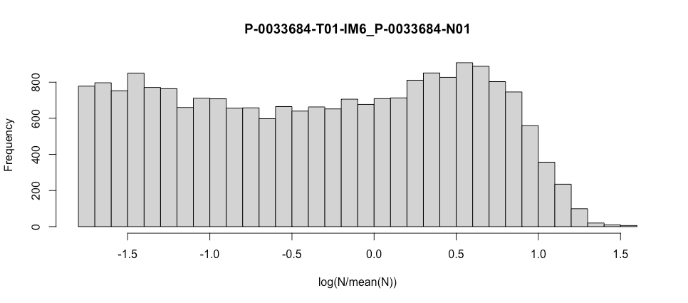
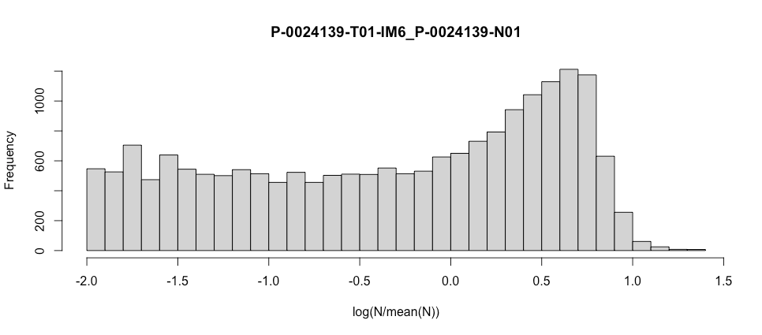
DryClean is ‘normal-agnostic’
Result 2
good (uniform) normal
Bad (uniform) normal
Facets-CnLR(atio) depend on the normal samples. Non-uniform distributions will skew the tumor profile

Slide 12
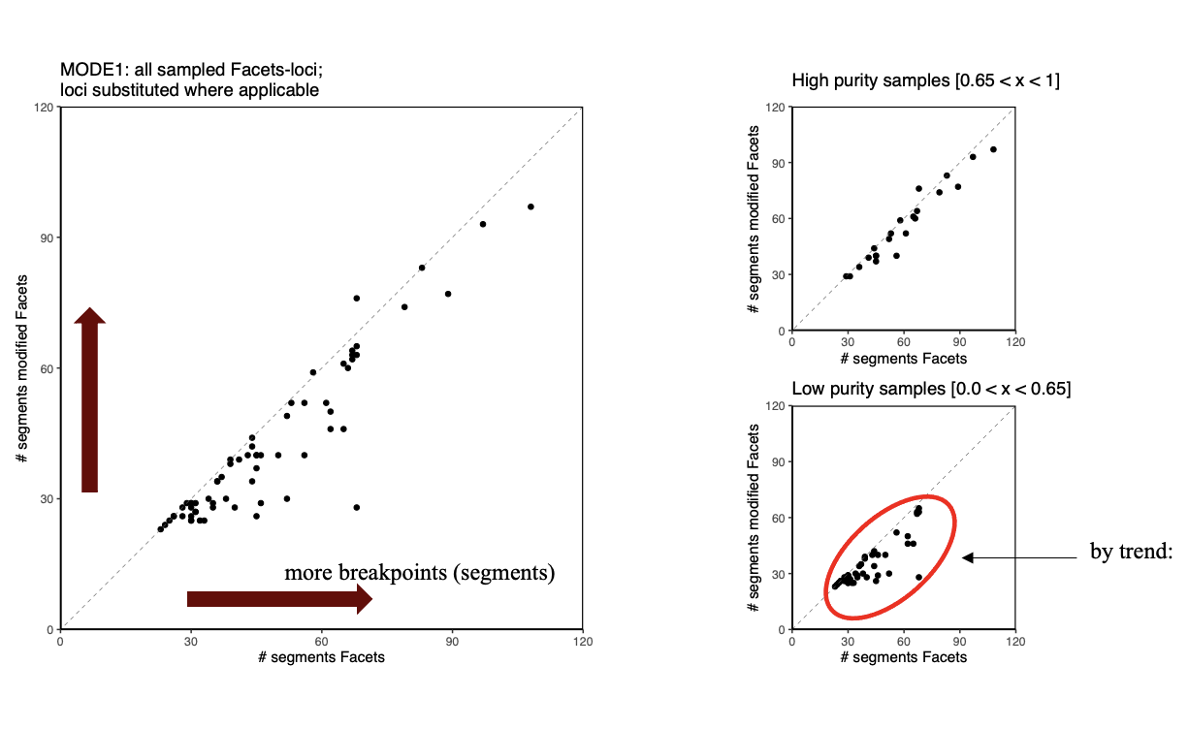
DryClean reduces (hyper-) segmentation, especially in low purity samples
Result 3: partial replacement

Slide 13
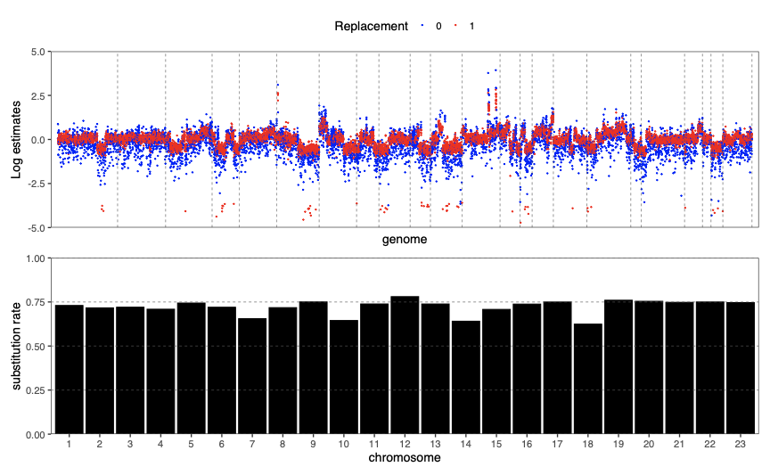
‘Partial’ replacement is uniform across the genome, and hence should not cause an issue
Result 4, partial replacement
Substitution rates vary between 56 and 94%
Average substitution = 74%

Slide 14
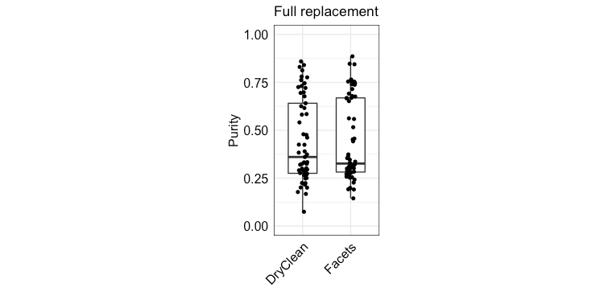
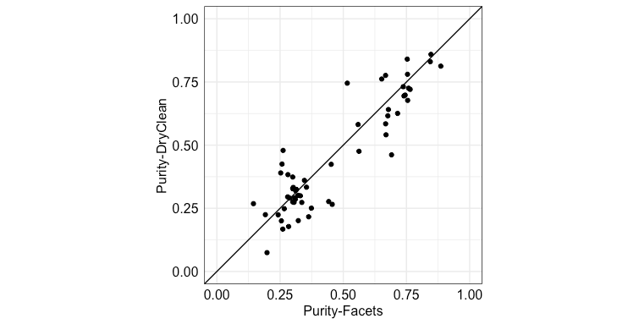
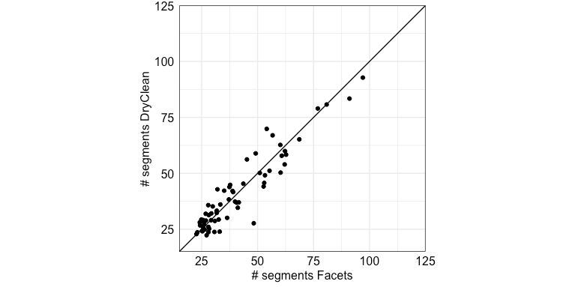
‘Full replacement’ doesn’t improve the calls
Result 5, full replacement
p[paired t.test] = 0.204
cor[pearson] = 94%
Full replacement == information loss

Slide 15
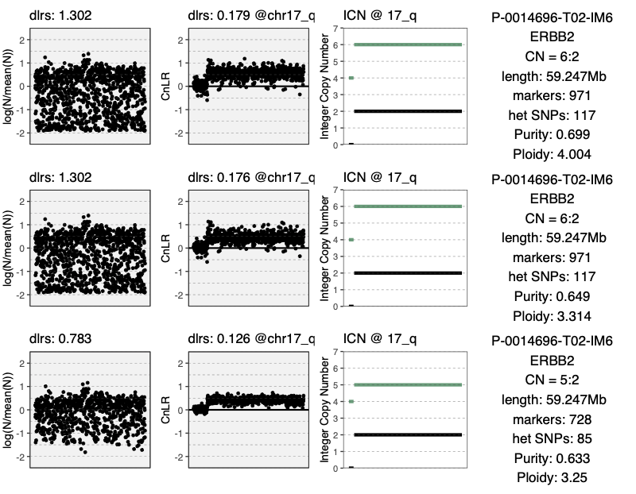
Focality? One case example with methodological concordance
Result 6
FACETS
WGD; allelic gain of ERBB2
WGD; allelic gain of ERBB2
partial
DryClean
WGD; allelic gain of ERBB2
full
DryClean
cBIO reports no alteration for ERBB2
quality of Normal

Slide 16
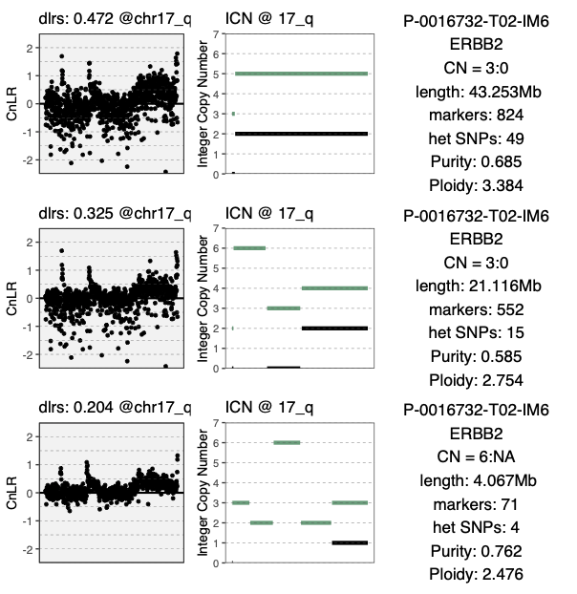
DryClean enables sensitive change-points detection
Result 7
FACETS
partial
DryClean
full
DryClean
cBIO reports no alteration for ERBB2
dlrs = derivative log2 ratio spread

Slide 17
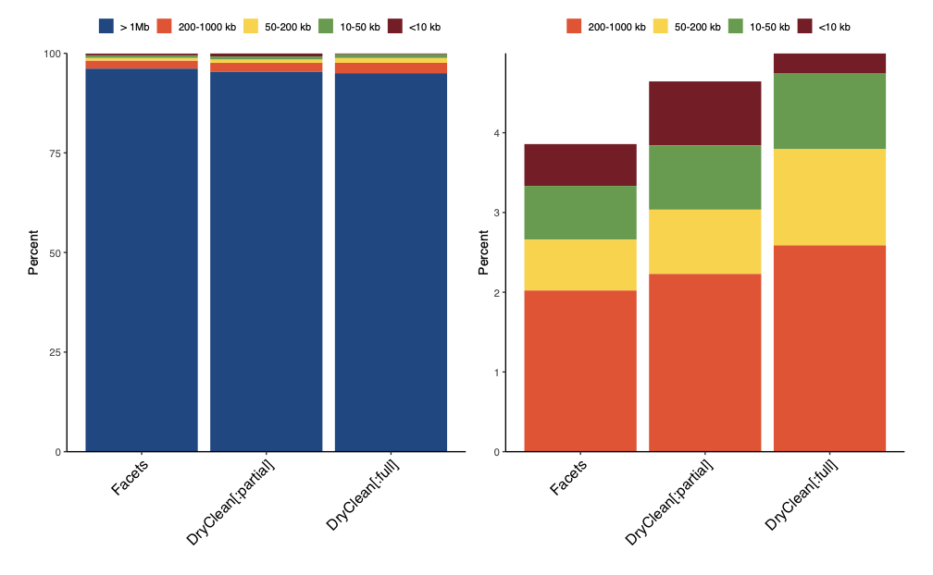
More focal events are captured with DryClean data
Result 7B
0.3%
0.8%
0.9%
0.5%
0.8%
0.7%

Slide 18
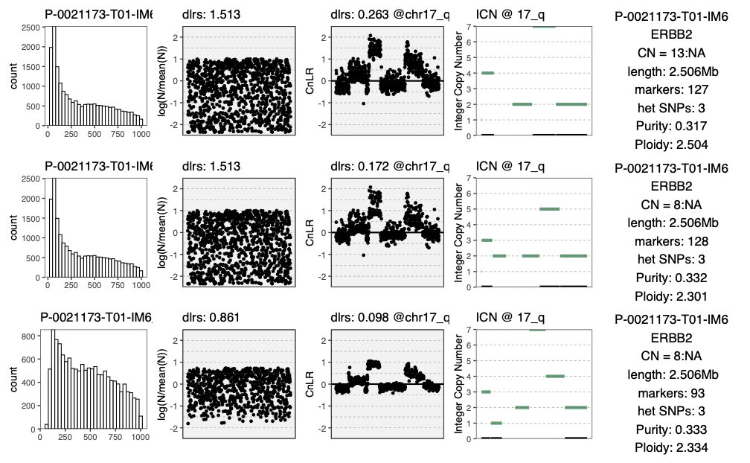
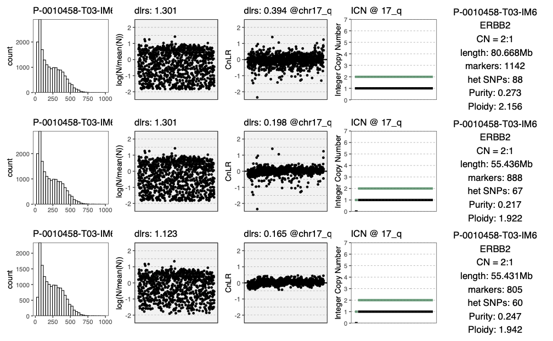
Focality:
wt - ERBB2 (2:1)
Consistent purity estimates (cBIO purity = 20%)
4 mutations (PIK3CA, TP53, KMT2C, MAP2K4
Tumor most likely driven by mutations
Genome (CNA) inconspicuous

Slide 19
High amplification

Slide 20
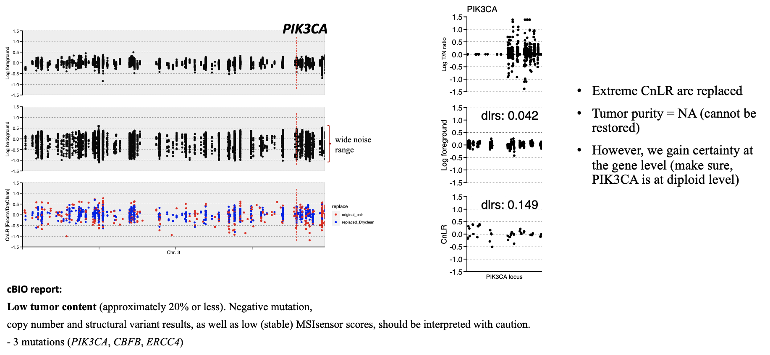
Poor data – stays poor data
case study: P-0021225-T01-IM6; primary breast cancer (55 y, f.)

Slide 21
Summary
Normal agnostic
GC bias (read depth) is eliminated
Segmentation pattern tends to be better in low purity samples
Focal events are captured
‘Full replacement’ - leads to information loss
Purity, Ploidy estimation: both measures depend on CNA burden (the lower CNA burden the lower the purity/ploidy)
? mis-match(es) especially with cBIO reports (6 ERBB2 amplifications which are not reported)
? Similar approach with WES data - can we justify the results?

Slide 22
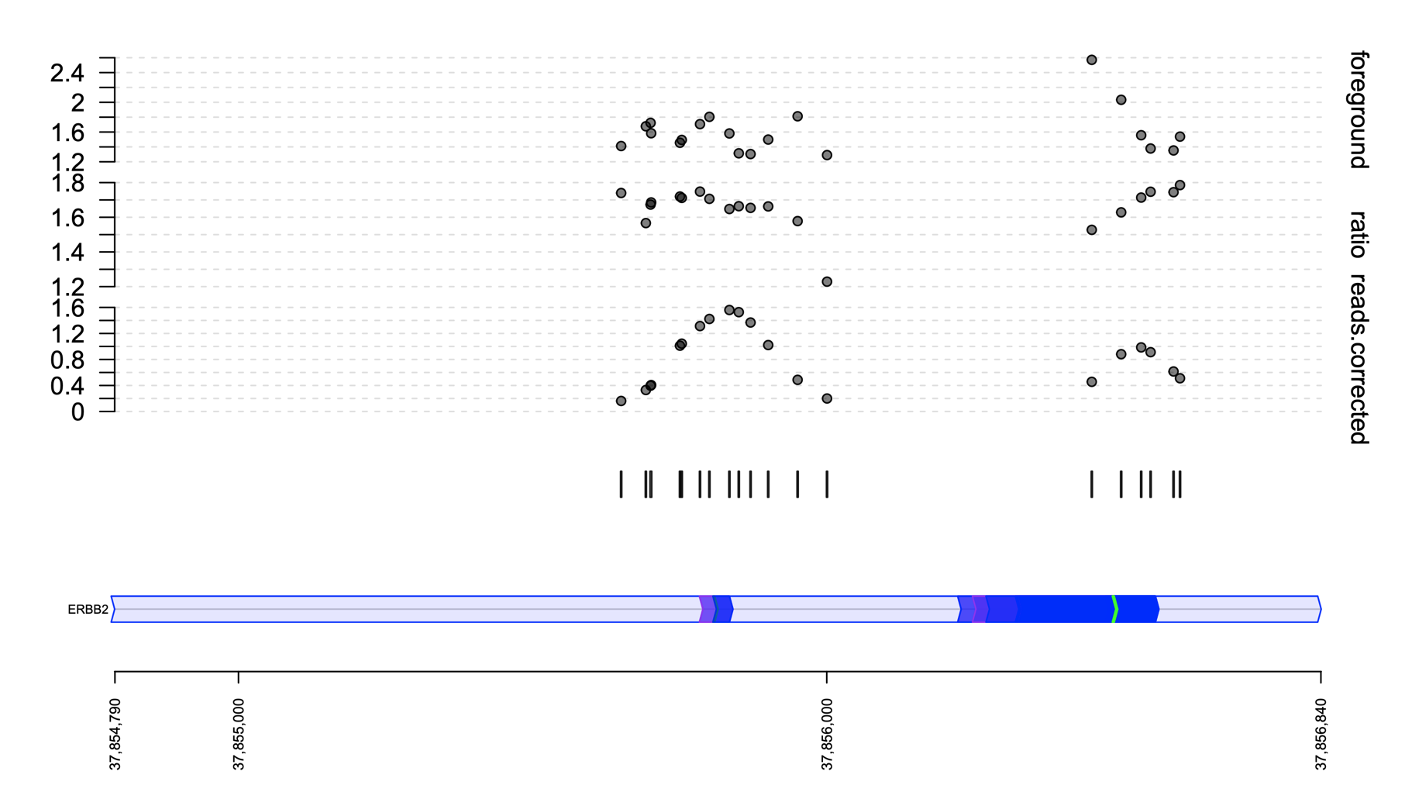
Reducing oversampling to improve dryclean performance
Additional pre-processing steps:
(1) collapsing the neighbouring probes (averaging the signal)
(2) filtering out regions that are too small (noise)
PON: 6799 x 992
“bell-shape curved” signal for exon regions in raw data

Slide 23
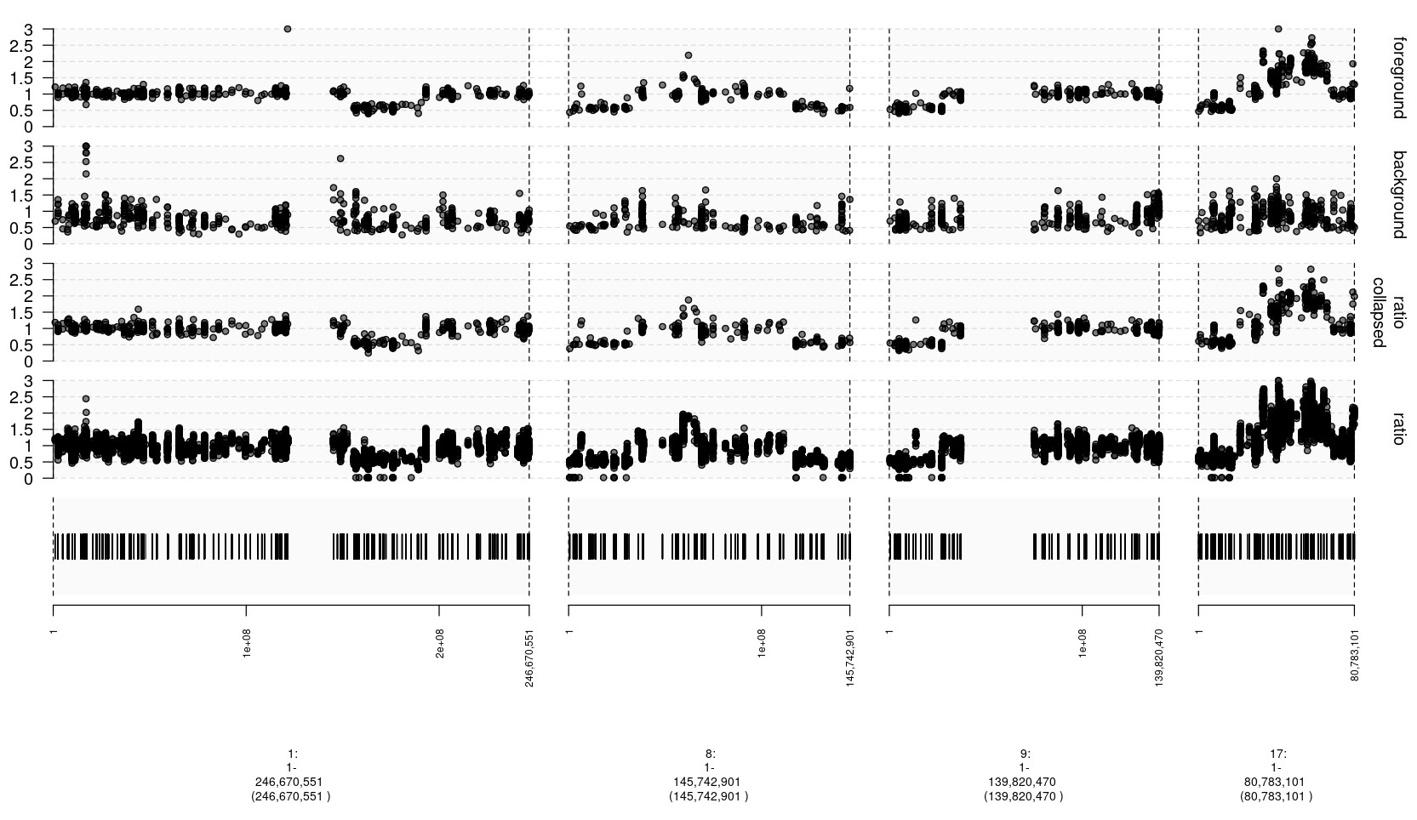
Reducing oversampling - high purity sample
P-0000584-T03-IM6
(purity: 0.87, ploidy: 2.1)
Notes:
P-0033684-T01-IM6
(purity: 0.31, ploidy: 5.3)
P-0000584-T03-IM6
(purity: 0.87, ploidy: 2.1)

Slide 24
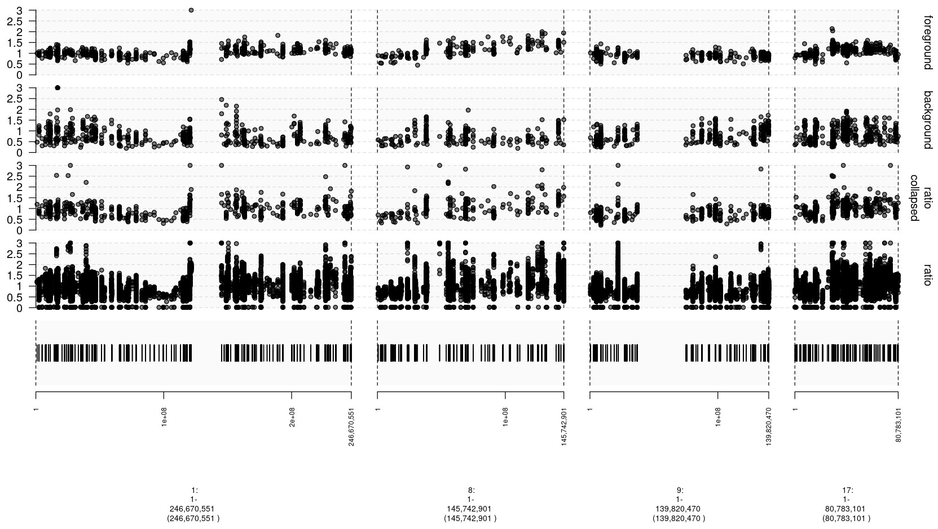
Reducing oversampling - low purity sample
P-0033684-T01-IM6
(purity: 0.31, ploidy: 5.3)
Notes:
P-0033684-T01-IM6
(purity: 0.31, ploidy: 5.3)
P-0000584-T03-IM6
(purity: 0.87, ploidy: 2.1)

Slide 25
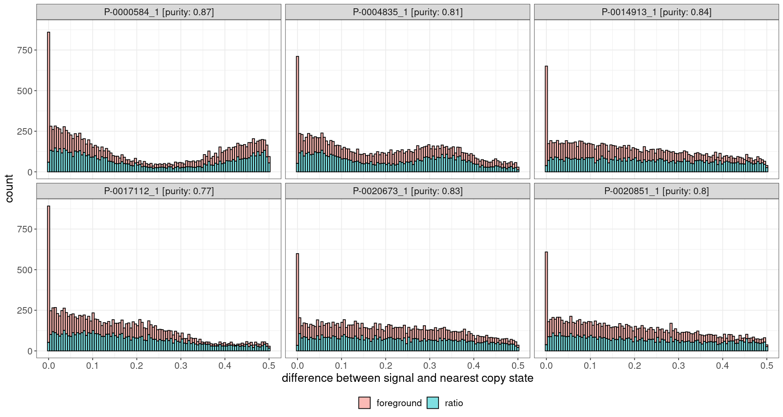
Dryclean + region collapsing impact (high purity samples)

Slide 26
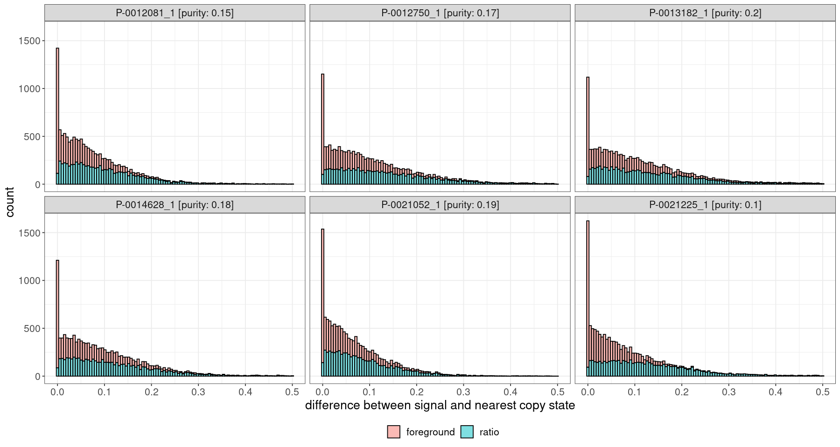
Dryclean + region collapsing impact (low purity samples)

Slide 27
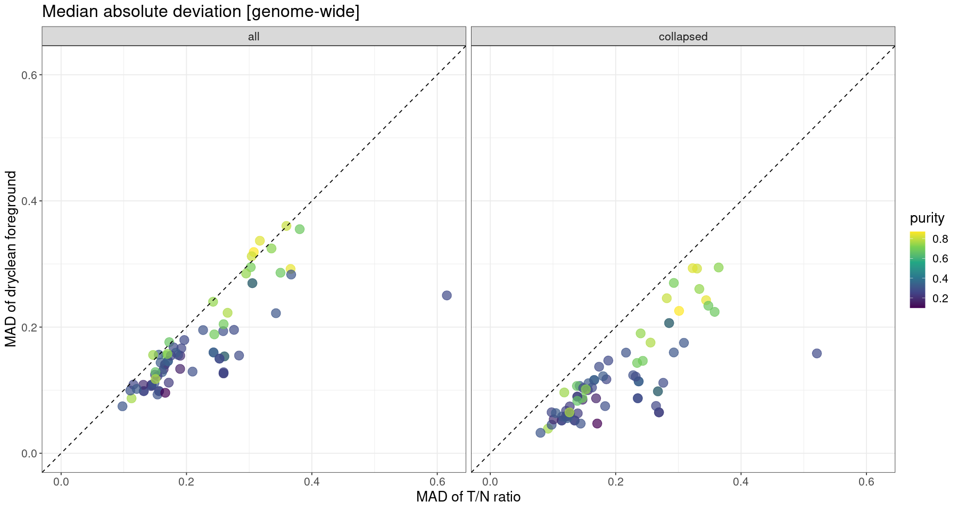
Dryclean + region collapsing impact - global view

